Slide 1
SS ZG 566 Secure Software Engineering
T V Rao

Slide 2
Phases in software development - Part 1 RL 2.1.1

Slide 3
Software Engineering - Definitions
(1969 – Fritz Bauer) Software engineering is the establishment and use of sound engineering principles in order to obtain economically software that is reliable and works efficiently on real machines
(IEEE) The application of a systematic, disciplined, quantifiable approach to the development, operation, and maintenance of software; that is, the application of engineering to software

Slide 4
Knowledge Areas in v3(2014) of SWEBOK
Requirements Design Construction Testing Maintenance | Configuration Management Quality Processes Models & Methods Engineering Management Project Management Economics

Slide 5
Software Engineering Process KA
A Process defines who is doing what, when, and how to reach a certain goal
-Ivar Jacobson, Grady Booch, and James Rumbaugh
A software process is a set of interrelated activities and tasks that transform input work products into output work products. At minimum, the description of a software process includes required inputs, transforming work activities, and outputs generated.
SWEBOK
A software process infrastructure can provide process definitions, policies for interpreting and applying the processes, and descriptions of the procedures to be used to implement the processes.
A software development life cycle (SDLC) includes the software processes used to specify and transform software requirements into a deliverable software product.

Slide 6
Prescriptive and agile processes
Prescriptive processes are processes where all of the process activities are planned in advance and progress is measured against this plan.
In agile processes, planning is incremental and it is easier to change the process to reflect changing customer requirements.
In practice, most practical processes may include elements of both plan-driven and agile approaches.
There are NO right or wrong software processes.

Slide 7
How Process Models Differ?
While all Process Models take same primary and supporting activities, they differ with regard to
Overall flow of activities, actions, and tasks and the interdependencies among them
Degree to which actions and tasks are defined within each framework activity
Degree to which work products are identified and required
Manner in which quality assurance activities are applied
Manner in which project tracking and control activities are applied
Overall degree of detail and rigor with which the process is described
Degree to which customer and other stakeholders are involved in the project
Level of autonomy given to the software team
Degree to which team organization and roles are prescribed

Slide 8
Software Requirements
The Software Requirements knowledge area (KA) is concerned with the elicitation, analysis, specification, and validation of software requirements as well as the management of requirements during the whole life cycle.
Software projects are critically vulnerable when the requirements related activities are poorly performed

Slide 9
Functional & Nonfunctional Requirements
Functional requirements describe the functions that the software is to execute; for example, formatting some text or modulating a signal. They are sometimes known as capabilities or features. A functional requirement can also be described as one for which a finite set of test steps can be written to validate its behavior.
Nonfunctional requirements are the ones that act to constrain the solution. Nonfunctional requirements are aka constraints or quality requirements. They can classified according to whether they are performance requirements, maintainability requirements, safety requirements, reliability requirements, security requirements, interoperability requirements

Slide 10
Emergent properties of software
Some requirements represent emergent properties of software—that is, requirements that cannot be addressed by a single component but that depend on how all the software components interoperate. The throughput requirement for a call center would, for example, depend on how the telephone system, information system, and the operators all interacted under actual operating conditions. Emergent properties are crucially dependent on the system architecture.
Experts consider Security as an emergent property of the software.

Slide 11
Software Design
Software design consists of two activities that fit between software requirements analysis and software construction:
Software architectural design (sometimes called high-level design): develops top-level structure and organization of the software and identifies the various components.
Software detailed design: specifies each component in sufficient detail to facilitate its construction.

Slide 12
Software Design
Software design principles include abstraction; coupling and cohesion; decomposition and modularization; encapsulation/information hiding; separation of interface and implementation; sufficiency, completeness, and primitiveness; and separation of concerns.
Design for security is concerned with how to prevent unauthorized disclosure, creation, change, deletion, or denial of access to information and other resources. It is also concerned with how to tolerate security-related attacks or violations by limiting damage, continuing service, speeding repair and recovery, and failing and recovering securely.

Slide 13
Software Construction
Software construction refers to the detailed creation of working software through a combination of coding, verification, unit testing, integration testing, and debugging.
Throughout construction, software engineers both unit test and integration test their work. Thus, the Software Construction KA is closely linked to the Software Testing KA.
Code is the ultimate deliverable of a software project, and thus the Software Quality KA is closely linked to the Software Construction KA.

Slide 14
Software Testing
Software testing consists of the dynamic verification that a program provides expected behaviors on a finite set of test cases, suitably selected from the usually infinite execution domain
Dynamic: The input value alone is not always sufficient to specify a test, since a system might react to the same input with different behaviors, depending on the system state.
Finite: Even in simple programs, so many test cases are theoretically possible that exhaustive testing is infeasible.
Selected: How to identify the most suitable test set under given conditions is a complex problem; in practice, risk analysis techniques and software engineering expertise are applied.
Expected: It must be possible, although not always easy, to decide whether the observed outcomes of program testing are acceptable or not.

Slide 15
Thank You!

Slide 16
SS ZG 566 Secure Software Engineering
T V Rao

Slide 17
Phases in software development - Part 2 RL 2.1.2

Slide 18
Software quality
Software quality may refer:
to desirable characteristics of software products,
to the extent to which a particular software product possess those characteristics, and
to processes, tools, and techniques used to achieve those characteristics
Experts defined variously
“conformance to requirements” - Phil Crosby
“achieving excellent levels of fitness for use” - Watt Humphrey
“market-driven quality” where the “customer is the final arbiter” - IBM

Slide 19
Software quality
A healthy software engineering culture includes the understanding that tradeoffs among cost, schedule, and quality are a basic tenant of the engineering of any product.
The tradeoff is best decided by understanding four cost of quality categories: prevention, appraisal, internal failure, and external failure.
Prevention costs include investments in software process improvement efforts, quality infrastructure, quality tools, training, audits, and management reviews
Appraisal costs arise from project activities that find defects.
Costs of internal failures are those that are incurred to fix defects found during appraisal activities and discovered prior to delivery of the software product to the customer
External failure costs include activities to respond to software problems discovered after delivery to the customer.

Slide 20
Configuration management
Configuration management (CM) is the discipline of identifying the configuration of a system at distinct points in time for the purpose of systematically controlling changes to the configuration and maintaining the integrity and traceability of the configuration throughout the system life cycle.
A system can be defined as the combination of interacting elements organized to achieve one or more stated purposes
Configuration of a software system is collection of specific versions of hardware, firmware, or software items combined according to specific build procedures for a purpose.

Slide 21
Software Maintenance
A software product must change or evolve over time. Once a software is in operation, defects are uncovered, operating environments change,and new user requirements surface.
Software maintenance is an integral part of a software life cycle. However, software development used to receive more importance than software maintenance in most organizations. It is changing
Due to large capital spending needed for software development, organizations are trying to maximize lifespan of existing software
Due to large scale availability of open source components, organizations increased focus on maintenance

Slide 22
Maintainer’s activities
Five key characteristics comprise the maintainer’s activities:
maintaining control over the software’s day-to-day functions;
maintaining control over software modification;
perfecting existing functions;
identifying security threats and fixing security vulnerabilities; and
preventing software performance from degrading to unacceptable levels.

Slide 23
Software Engineering Management
Software engineering management can be defined as the application of management activities — planning, coordinating, measuring, monitoring, controlling, and reporting — to achieve quality etc.
There are aspects specific to software projects and software life cycle that complicate effective management, including
Clients often don’t know what is needed or what is feasible
As a result of changing requirements, software is often built using an iterative process
The degree of novelty and complexity is often high
There is often a rapid rate of change in the underlying technology

Slide 24
Software Engineering Economics
Software engineering economics is about relating the attributes of software and software processes to economic measures
involves balancing risk and profitability, while maximizing benefits and wealth of the organization.
identify organizational goals, time horizons, risk factors, and financial constraints
identify and implement the appropriate portfolio and investment decisions to manage cash flow, and funding;
measure financial performance, such as cash flow and ROI

Slide 25
Software Engineering Process
software process is a set of interrelated activities and tasks that transform input work products into output work products
a software process includes required inputs, transforming work activities, and outputs generated
a software process may also include its entry and exit criteria and decomposition of the work activities into tasks, which are the smallest units of work
Value individuals & interactions over processes & tools – Agile manifesto
Agile models are designed to facilitate evolution of the software requirements during the project

Slide 26
Software Engineering Professional Practice
Software Engineering Professional Practice includes knowledge, skills, and attitudes that software engineers must possess to practice software engineering in a professional, responsible, and ethical manner
The concept of professional practice becomes applicable within the professions that have a generally accepted body of knowledge
A code of ethics and professional conduct for software engineering was approved by the ACM Council and the IEEE CS Board of Governors in 1999
Software engineers shall commit themselves to making the analysis, specification, design, development, testing and maintenance of software a beneficial and respected profession. In accordance with their commitment to the health, safety and welfare of the public, software engineers shall adhere to the eight principles concerning the public, client and employer, product, judgment, management, profession, colleagues, and self, respectively

Slide 27
Thank You!

Slide 28
SS ZG 566 Secure Software Engineering
T V Rao

Slide 29
Work products during SDLC RL 2.2

Slide 30
Requirement Models
Scenario-based modeling – represents the system from the user's point of view
Flow-oriented modeling – provides an indication of how data objects are transformed by a set of processing functions
Class-based modeling – defines objects, attributes, and relationships
Behavioral modeling – depicts the states of the classes and the impact of events on these states

Slide 31
Use-Cases
A collection of user scenarios that describe the thread of usage of a system
Each scenario is described from the point-of-view of an “actor”—a person or device that interacts with the software in some way
Each scenario answers the following questions:
Who is the primary actor, the secondary actor (s)?
What are the actor’s goals?
What preconditions should exist before the story begins?
What main tasks or functions are performed by the actor?
What extensions might be considered as the story is described?
What variations in the actor’s interaction are possible?
What system information will the actor acquire, produce, or change?
Will the actor have to inform the system about changes in the external environment?
What information does the actor desire from the system?
Does the actor wish to be informed about unexpected changes?

Slide 32
Use case—detailed example (Pressman)
Example: “SAFEHOME” system (Pressman)
Use case name: InitiateMonitoring
Participating actors: homeowner, technicians, sensors
Flow of events (homeowner):
--Homeowner wants to set the system when the homeowner leaves house or remains in house
--Homeowner observes control panel
--Homeowner enters password
--Homeowner selects “stay” or “away”
--Homeowner observes that read alarm light has come on, indicating the system is armed

Slide 33
Use case—detailed example (Pressman)
Pre condition(s)
Homeowner decides to set control panel
Post condition(s)
Control panel is not ready; homeowner must check all sensors and reset them if necessary
Control panel indicates incorrect password (one beep)—homeowner enters correct password
Password not recognized—must contact monitoring and response subsystem to reprogram password
Stay selected: control panel beeps twice and lights stay light; perimeter sensors are activated
Away selected: control panel beeps three times and lights away light; all sensors are activated

Slide 34
Use case—detailed example (Pressman)
Quality requirements:
Control panel may display additional text messages
time the homeowner has to enter the password from the time the first key is pressed
Ability to activate the system without the use of a password or with an abbreviated password
Ability to deactivate the system before it actually activates

Slide 35
Misuse case (techtarget.com)
Name: Attack on "forgot password" functionality Summary: A malicious user tries to attack the "forgot password" functionality in order to gain access to the Web application or guess a valid e-mail address Author: Anurag Agarwal Date: April 15, 2006
Possible Attacks:
SQL injection attack
Brute force attack to guess a valid user
Sniffing attack on e-mail sent with password on an insecure transmission channel
Trigger Point: Can happen anytime
Preconditions: None
Assumptions:
The attacker can perform this attack remotely over the Internet
The attacker can be an anonymous user

Slide 36
Misuse case (techtarget.com)
Worst case threat (post condition) :
Attacker gains entry into the company database and steals sensitive information
Attacker is able to modify an existing e-mail address to its own e-mail address and mails the password to himself to gain unauthorized entry into the system
Related business rule:
The system should e-mail the password to a valid e-mail address entered
Capture guarantee (post condition) :
Attacker cannot gain access to the database to steal or modify information
Attacker cannot identify the e-mail address of a valid user
Attacker cannot view the password sent in an e-mail to an e-mail address of a valid user

Slide 37
Misuse case (techtarget.com)
Potential misuser profile:
Script kiddie
Skilled attacker
Threat level: High
Mitigation steps:
SQL injection attack
List all the mitigation steps to avoid a SQL injection attack.
Brute force attack
Accept first name, last name along with e-mail address
Have proper error handling so as not to reveal information to the attacker
Delay 3 to 5 seconds before re-entering the e-mail address
Lock out page for that IP address after 10 attempts
Sniffing attack
Send password e-mail on a secure transmission channel with strong encryption

Slide 38
Data Flow Modeling
Data Flow Diagram
Depicts how input is transformed into output as data objects move through a system
Process Specification
Describes data flow processing at the lowest level of refinement in the data flow diagrams

Slide 39
Data Flow Modeling
Guidelines
Depict the system as single bubble in level 0.
Carefully note primary input and output.
Refine by isolating candidate processes and their associated data objects and data stores.
Label all elements with meaningful names.
Maintain information conformity between levels.
Refine one bubble at a time.

Slide 40
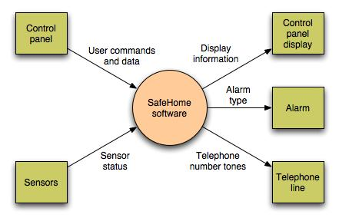
Data Flow Diagram

Slide 41
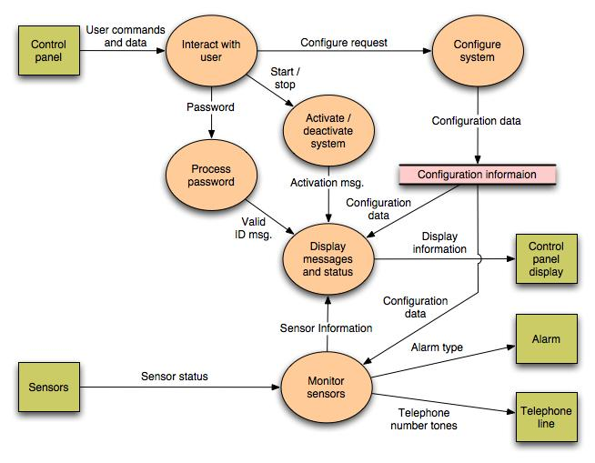
Data Flow Diagram (Next Level)

Slide 42
Thank You!

Slide 43
SS ZG 566 Secure Software Engineering
T V Rao

Slide 44
Security implications to SDLC – Part 1 RL 2.3.1

Slide 45
OWASP SAMM
SAMM (Software Assurance Maturity Model) is the OWASP framework to help organizations assess, formulate, and implement a strategy for software security, that can be integrated into their existing Software Development Lifecycle (SDLC)
SAMM is based around a set of 12 security practices, which are grouped into four business functions
Every security practice contains a set of activities, structured into three maturity levels (1-3).

Slide 46
OWASP SAMM Overview

Slide 47
SAMM Checklist (partial) for Governance
Do the business stakeholders understand your organization’s risk profile?
Are many of your applications and resources categorized by risk?
Does your organization regularly compare your security spend with that of other organizations?
Does the organization utilize a set of policies and standards to control software development?
Are projects periodically audited to ensure a baseline of compliance with policies and standards?
Does each project team understand where to find secure development best-practices and guidance?
Are stakeholders able to pull in security coaches for use on projects?
Are developers tested to ensure a baseline skillset for secure development practices?

Slide 48
SAMM Checklist (partial) for Construction
Do projects in your organization consider and document likely threats?
Do project teams regularly analyze functional requirements for likely abuses?
Do project teams specifically consider risk from external software?
Do project teams specify security requirements during development?
Do project teams specify requirements based on feedback from other security activities?
Do stakeholders review vendor agreements for security requirements?
Are project teams aware of secure design principles and do they apply them consistently?
Do project teams build software from centrally controlled platforms and frameworks?
Are project teams audited for the use of secure architecture components?

Slide 49
SAMM Checklist (partial) for Verification
Do project teams document the attack perimeter of software designs?
Do project teams specifically analyze design elements for security mechanisms?
Does a minimum security baseline exist for secure design review results?
Do project teams review selected high-risk code?
Can project teams access automated code analysis tools to find security problems?
Do projects specify security testing based on defined security requirements?
Are security test cases comprehensively generated for application-specific logic?
Do projects follow a consistent process to evaluate and report on security tests to stakeholders?

Slide 50
SAMM Checklist (partial) for Operations
Does your organization have an assigned security response team?
Are project stakeholders aware of relevant security disclosures related to their software projects?
Are incidents inspected for root causes to generate further recommendations?
Do projects check for security updates to third-party software components?
Do projects document operational environment security requirements?
Are security notes delivered with each software release?
Do project teams deliver an operational security guide with each product release?

Slide 51
OWASP SAMM Practices
SAMM prescribes methodology for practice that includes
Assessment
Results
Success metrics
Costs
Personnel (Roles)
Levels

Slide 52
Thank You!

Slide 53
SS ZG 566 Secure Software Engineering
T V Rao

Slide 54
Security implications to SDLC – Part 2 RL 2.3.2

Slide 55
Security Development Lifecycle
The Security Development Lifecycle (SDL) is a security assurance process developed by Microsoft as a company-wide initiative and a mandatory policy to reduce the number and severity of vulnerabilities in software products.
The Microsoft SDL is based on three core concepts —
education,
continuous process improvement, and
accountability

Slide 56
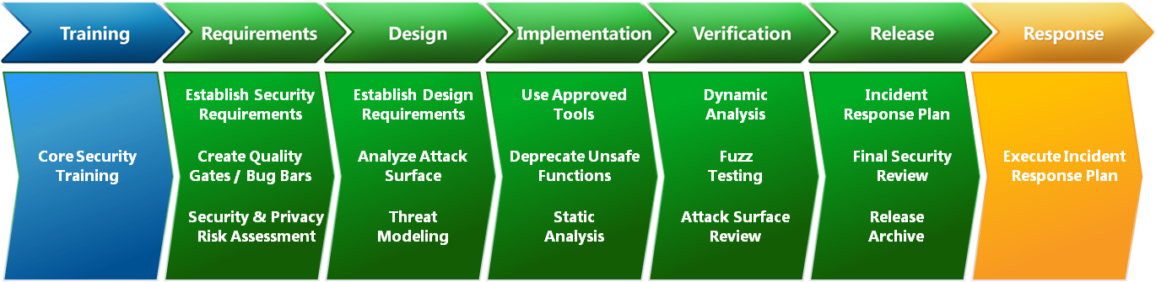
Security Development Lifecycle

Slide 57
SDL - Core Security Training
Basic software security training should cover foundational concepts such as:
- Secure design, including the following topics: Attack surface reduction, Defense in depth, principle of least privilege, Secure defaults
- Threat modeling, including the following topics: Overview of threat modeling, Design implications of a threat model, Coding constraints based on a threat model
- Secure coding, including the following topics: Buffer overruns (for applications using C and C++), Integer arithmetic errors (for applications using C and C++), Cross-site scripting (for managed code and Web applications), SQL injection (for managed code and Web applications), Weak cryptography
- Security testing, including the following topics: Differences between security testing and functional testing, Risk assessment, Security testing methods
- Privacy, including the following topics: Types of privacy-sensitive data, Privacy design best practices, Risk assessment, Privacy development best practices, Privacy testing best practices

Slide 58
SDL Roles
SDL roles are designed to provide project security and privacy oversight and have the authority to accept or reject security and privacy plans from a project team.
Security Advisor/Privacy Advisor. This role is filled by subject-matter experts (SMEs) from outside the project team. The person chosen for this task must fill two sub-roles:
Auditor: monitors each phase of the software development process and attest to successful completion of each security requirement
Expert: must possess verifiable subject-matter expertise in security.
Team Champion. should be filled by SMEs from the project team. Responsible for the negotiation, acceptance, and tracking of minimum security and privacy requirements

Slide 59
Some SDL Practices
Threat Modeling
used in environments where there is meaningful security risk
allows development teams to consider, document, and discuss the security implications of designs in the context of their planned operational environment
Threat modeling is a team exercise, encompassing program/project managers, developers, and testers, performed during the software design stage
Attack Surface Reduction
a means of reducing risk by giving attackers less opportunity to exploit a potential weak spot or vulnerability
encompasses shutting off or restricting access to system services, applying the principle of least privilege, and employing layered defenses wherever possible

Slide 60
Some SDL Practices
Static Analysis
The team should be aware of the strengths and weaknesses of static analysis tools and be prepared to augment static analysis tools with other tools or human review as appropriate
Dynamic Program Analysis
specify tools that monitor application behavior for memory corruption, user privilege issues, and other critical security problems
Fuzz Testing
a specialized form of dynamic analysis used to induce program failure by deliberately introducing malformed or random data to an application

Slide 61
Some SDL Practices
Final Security Review
a deliberate examination of all the security activities performed on a software application prior to release
performed by the security advisor with assistance from the regular development staff and the security and privacy team leads
includes an examination of threat models, exception requests, tool output, and performance against the previously determined quality gates or bug bars
If a team does not meet all SDL requirements and the security advisor cannot approve the project, the project cannot be released
Teams must either address whatever SDL requirements that they can prior to launch or escalate to executive management for a decision

Slide 62
Software Engineering: A Practitioner's Approach, 7/e Roger Pressman
Software Engineering, Pearson Education, 9th Ed., 2010. Ian Sommerville
SWEBOK by IEEE/ACM
www.owasp.com
www.microsoft.com

Slide 63
Thank You!

